Slide 1
TypeScript
Variables, Types and Enums
Lecture 2
By James(Jin) Wang
11/15/2021

Slide 2
Outline
Benefits of Types
Built-in Types
Using Typed Variables
Using Enums

Slide 3
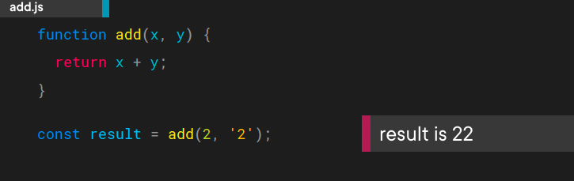
Benefits of Types
  What is the result of calling the add() function?

Slide 4
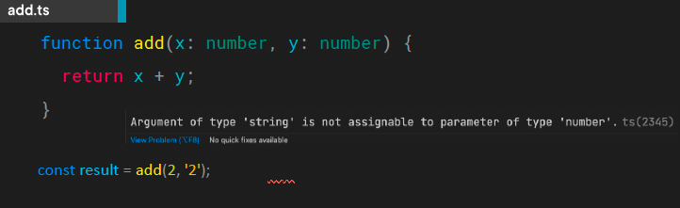
Benefits of Types
  TypeScript allows types to be added to variables and parameters.

Slide 5
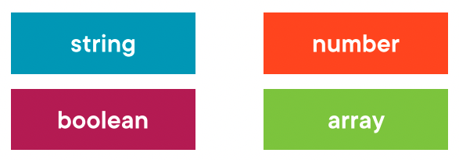
Built-in Types

Slide 6
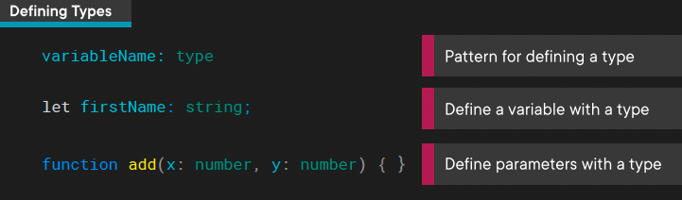
Built-in Types
  TypeScript types can be used on variables and parameters following the variableName: type pattern.

Slide 7
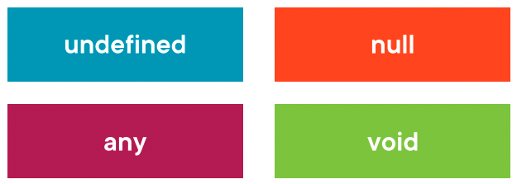
Built-in Types
  Additional Built-in Types

Slide 8
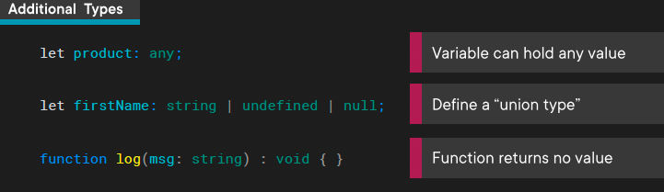
Built-in Types
  Additional types such as any, void, undefined, null and others exist in TypeScript.
  In cases where a variable can be one or more types a union type can be used.

Slide 9
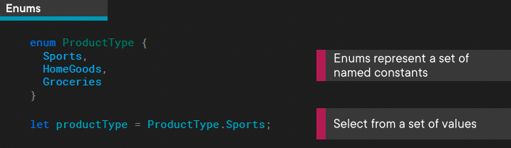
Built-in Types
  An enum represent a set of name constants.
  Enums are not a ”type-level” extension of JavaScript. They generate JavaScript code that is used at runtime.

Slide 10
Using Typed Variables
  Demo: Typed Variables

Slide 11
Using Enums
  Demo: Enums

Slide 12
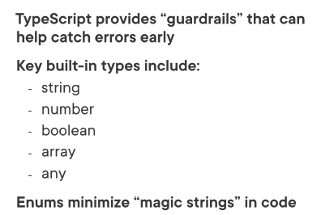
Summary

Slide 13
Assignment

Slide 14
Self Study
  Typescript Core Language Path
  TypeScript: The Big Picture
  https://app.pluralsight.com/library/courses/typescript-big-picture
  TypeScript: Getting Started
  https://app.pluralsight.com/library/courses/getting-started-typescript

